Slide 1
Gender and Racial Bias as Related to Police Treatment in Chapel Hill
By pd.read_csv('winning_team.csv')
Ishaan, Sam, Alaina, and Zubair

Slide 2
Do Gender and Race Have an Impact on Police Arrests in Chapel Hill?
We attempted to answer this question using the crime datasets provided as well as information from the Official United States Census.
We used Python to analyze the datasets and create visualizations which display the data in an easily understandable way.

Slide 3
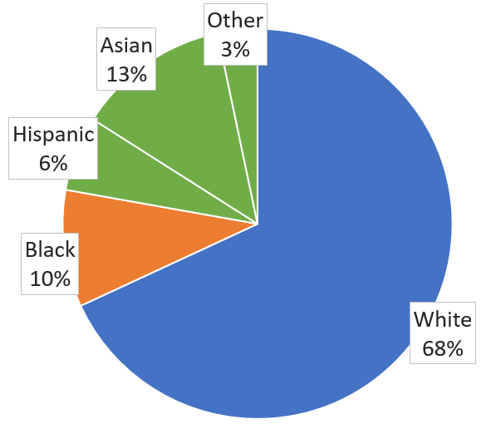
Official US Census Data for Chapel Hill, NC
If there is no bias in the way that police treat people of different races, ratios of arrests should reflect the ratio of races in the general population.
Data obtained from:
https://www.census.gov/quickfacts/fact/table/chapelhilltownnorthcarolina/PST045218
Notes:
15080

Slide 4
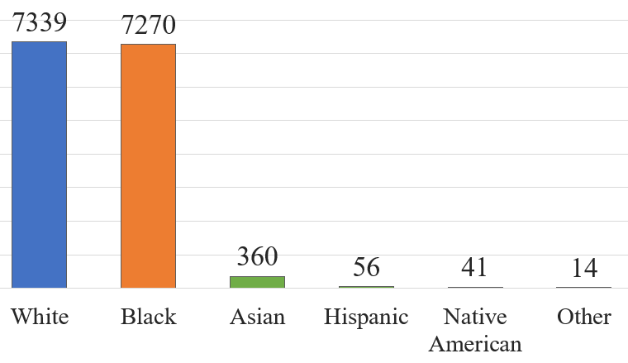
Arrests Made By Race
almost as many blacks as whites are arrested
census reports more than six times as many whites as blacks
arrest rates indicate bias

Slide 5
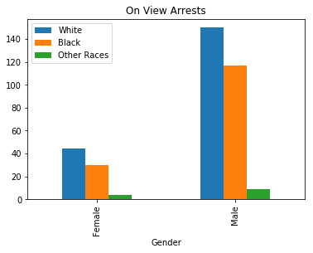
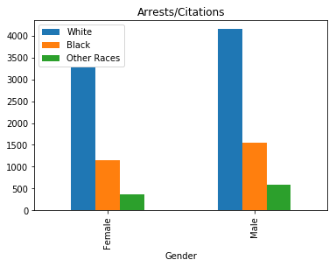
Arrests and Citations for Cars Pulled Over
Notes:
From an outside dataset, we are able to see what enforcement was actually taken on cars that got pulled over. From this we found that for both genders, roughly ⅓ of black people have gotten pulled over as white people. (click slide) When it comes to total arrests/orders to go to court, this ratio stays about the same.

Slide 6
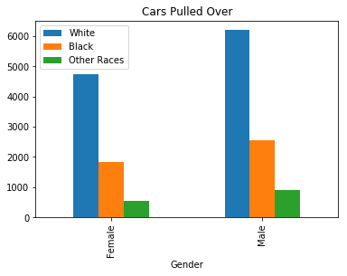
On-View Arrests for Cars Pulled Over
Notes:
However, if we look at this again and only look at how many people get arrested on-the-spot by police officers, (click) we can see that the rate drastically goes up for, shooting up to about 75% of black females and about 85% of black males getting arrested on the spot compared to their white counterparts.

Slide 7
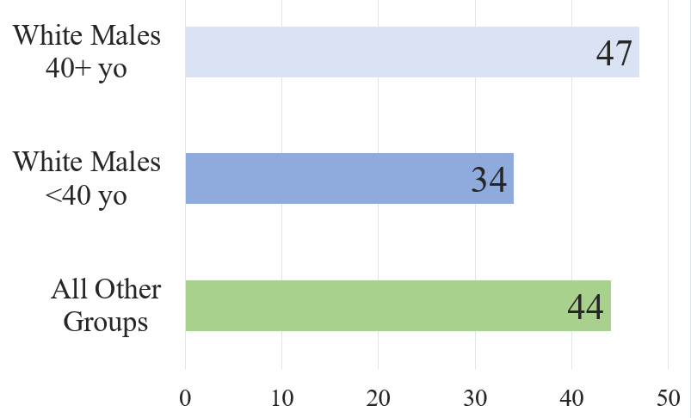
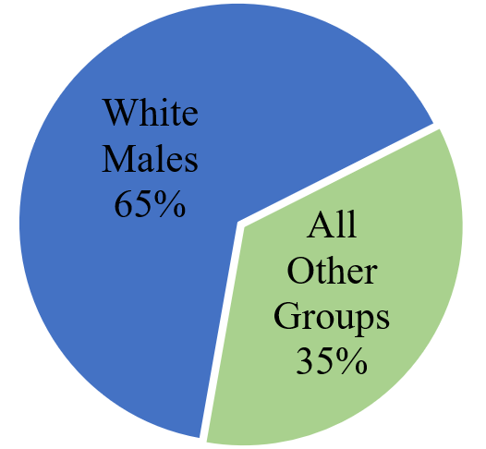
Race and Gender Distribution in Full Time Chapel Hill Police Officers
Lack of diversity in the police force could be one explanation for the bias seen in arrests.

Slide 8
Conclusion
We believe that the data we analyzed may indicate a police arrest bias due to race.
One possibility which we have found for the bias is lack of diversity within the Chapel Hill police force.
Questions?

